Slide 1
Site 24x7 Monitors
Visualization & Reporting

Slide 2
Overview
All-in-One Monitoring Solution
Mobile, Website
Web Application Monitoring
Application Performance Monitoring
Server Monitoring
Public & Private Cloud Monitoring
Network Monitoring
Lower Cost Monitoring Solution
$35/month
Includes 40 Websites, Servers/Basic monitors
1 min Poll Frequency
Includes 3 Synthetic Web Transactions
500K RUM Pageviews
Select 8 Test Locations

Slide 3
API
Integrate Site24x7 Data into Your Portal
Add monitors into Site24x7
Modify/delete/suspend monitors
Obtain availability and response time graphs
View current uptime status and response time of all monitors
List the last 'x' downtimes of all monitors
Obtain consolidated uptime and performance reports for a specific time period.

Slide 4
D3.JS + JQuery
D3.js -
JavaScript library for manipulating documents based on data.
Creates visualization using HTML, SVG, and CSS.
jQuery –
Fast, small, and feature-rich JavaScript library.
Used for HTML document traversal and manipulation, event handling & animation.
Easy-to-use Ajax API that works across a multitude of browsers.

Slide 5
Demo
http://localhost/d3/index_tree.html

Slide 6
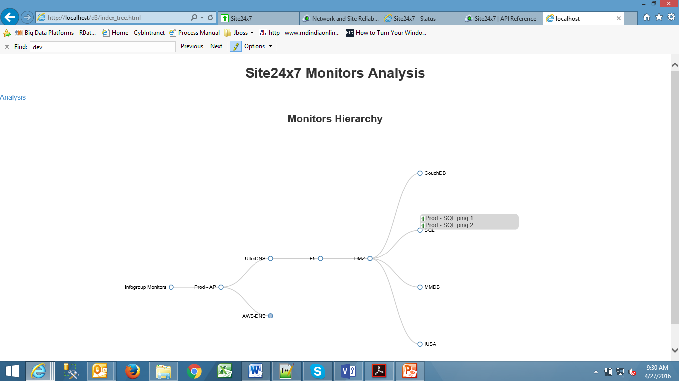
Hierarchy

Slide 7
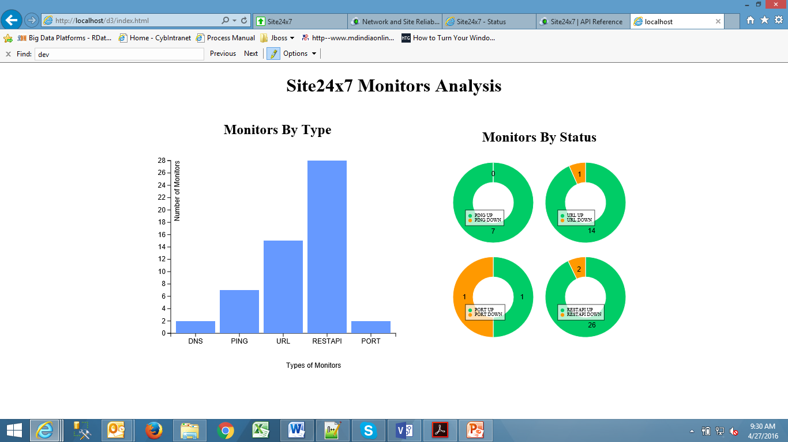
Analysis

